Slide 1
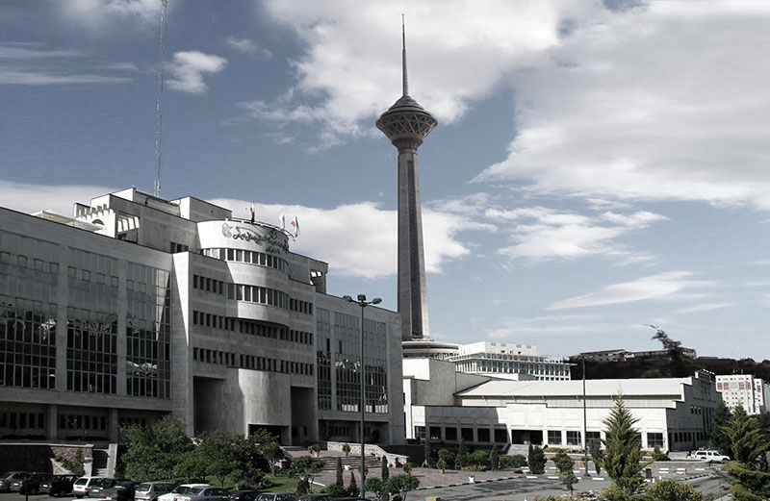
Presentation title
Iranian Congress of Epidemiology
10th National, and
3rd International
Presenter’s Name

Slide 2
01
Template with sections
You can enter a subtitle here if you need it

Slide 3
Contents of this presentation
Part 1 | Description
Part 2 | Description
Part 3 | Description
Part 4 | Description
Part 5 | Description
Part 6 | Description

Slide 4
Template for texts
Text
Text
Text
Text
Text
Text
Text
Text
Text
Text
Text
Text
Text
Text

Slide 5
Template with photo
Images reveal large amounts of data, so remember: use an image instead of a long text. Your audience will appreciate it

Slide 6
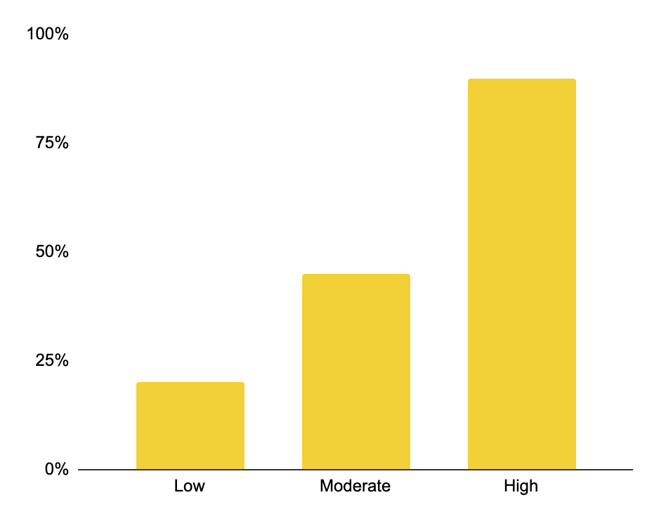
Template with chart
Low
Jupiter doesn’t have a solid surface
Moderate
Venus has a toxic atmosphere
High
Mars is made of basalt

Slide 7
Thanks!
This can be the part of the presentation where you introduce yourself, write your gratitude

Slide 8
References
Topic 1:
Reference details
Reference details
Reference details
Reference details
Reference details
Reference details
Reference details
Reference details
Reference details
Reference details
Reference details
Reference details
Reference details
Reference details
Reference details
Reference details
Reference details
Reference details
Reference details
Topic 2:
Reference details
Reference details
Reference details
Reference details
Reference details
Reference details

